Slide 1
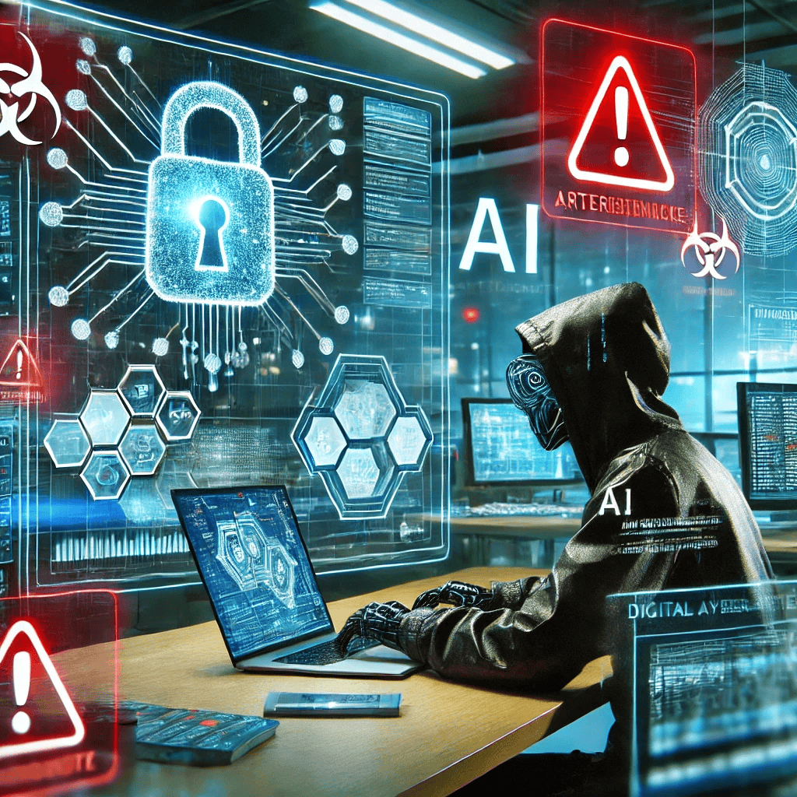
Navigating Ethical, Security, and Societal Challenges in Artificial Intelligence (AI)
Examining the Pros and Cons for a Responsible AI Future
Joshua Ibibo
PhD Cyber Security Researcher, UK
1

Slide 2
Presentation Outline
Part 1: Introduction to AI’s Ethical, Security, and Societal Challenges
Part 2: The Potential Drawbacks of AI
Part 3: Ethical & Privacy Concerns in AI
Part 4: AI & Job Displacement
Part 5: AI Privacy & Security Concerns
Part 6: Security Risks and AI-Powered Cyberattacks
Part 7: The Need for Transparency & AI Regulations
Part 8: The Future of AI & Responsible AI Development
Part 9: Conclusion & Call to Action
TechLink Innovations...
25/01/2025
2
Notes:
2
02/03/2025

Slide 3
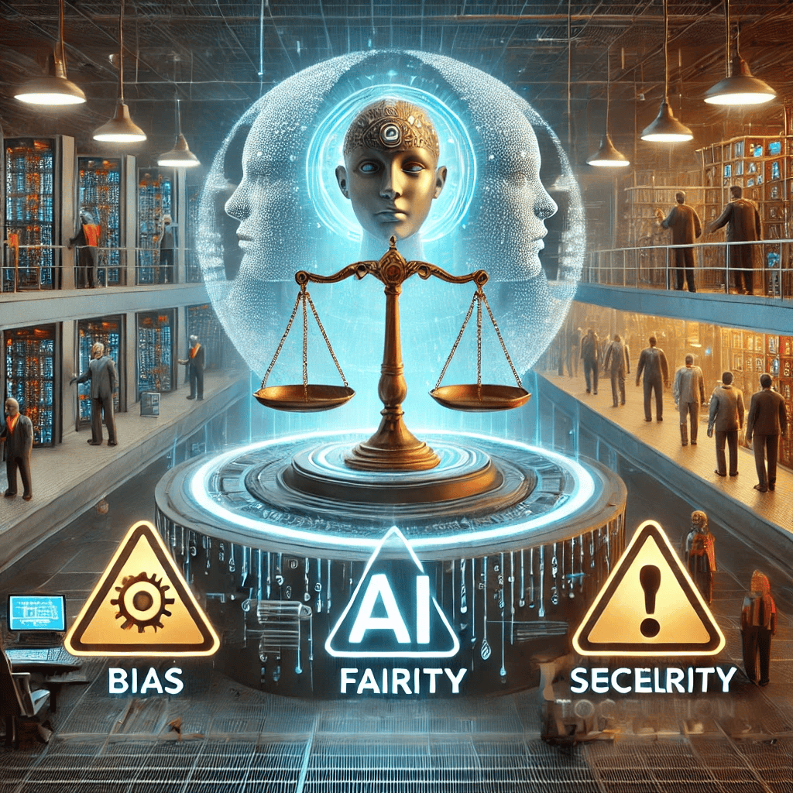
Introduction to AI’s Ethical, Security, and Societal Challenges
Key Points:
Artificial Intelligence (AI) is revolutionizing industries but comes with significant risks.
Ethical concerns, job displacement, security threats, and privacy issues must be addressed.
The need for transparency and regulatory frameworks is more critical than ever.
Fact: AI ethics violations have led to multiple lawsuits and data breaches, impacting millions of users globally (Forbes, 2024).
Image of an AI-generated conceptual illustration of AI’s Ethical, Security, and Societal Challenges, highlighting bias, cybersecurity risks, and job displacement.
TechLink Innovations...
27/02/2025
3
Notes:
3
02/03/2025

Slide 4
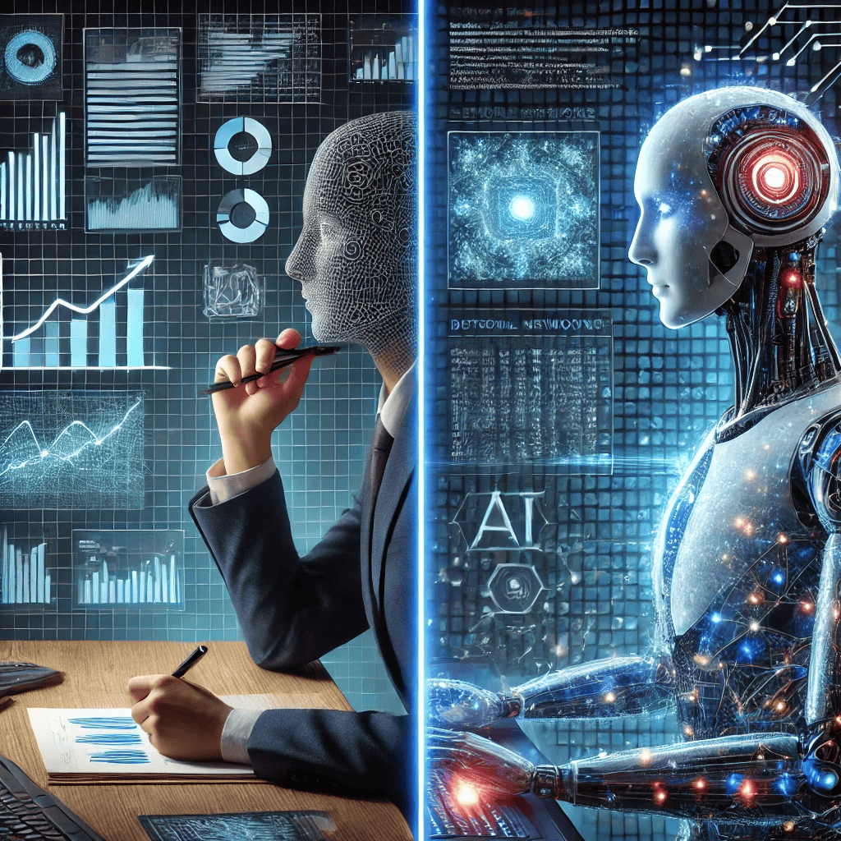
The Potential Drawbacks of AI: Challenges AI Poses to Society
Bias in AI Systems:
AI models trained on biased data can lead to discriminatory outcomes in hiring, policing, and lending.
Example: A study found AI hiring systems discriminated against women (MIT Tech Review, 2023).
ii. Lack of Explainability & Transparency:
AI decisions are often opaque, making accountability difficult.
Example: The "black box" nature of deep learning models limits their trustworthiness.
Image of an AI-generated image comparing human vs. AI decision-making. It visually contrasts human intuition and traditional analysis with AI's speed and data-processing efficiency.
TechLink Innovations...
27/02/2025
4
Notes:
4
02/03/2025

Slide 5
The Potential Drawbacks of AI: Challenges AI Poses to Society Cont.
Over-reliance on AI:
AI dependence in critical sectors (e.g., healthcare, finance) may lead to catastrophic failures.
Fact: AI-powered trading bots contributed to a market crash in 2022 (Financial Times, 2023).
TechLink Innovations...
27/02/2025
5
Notes:
5
02/03/2025

Slide 6
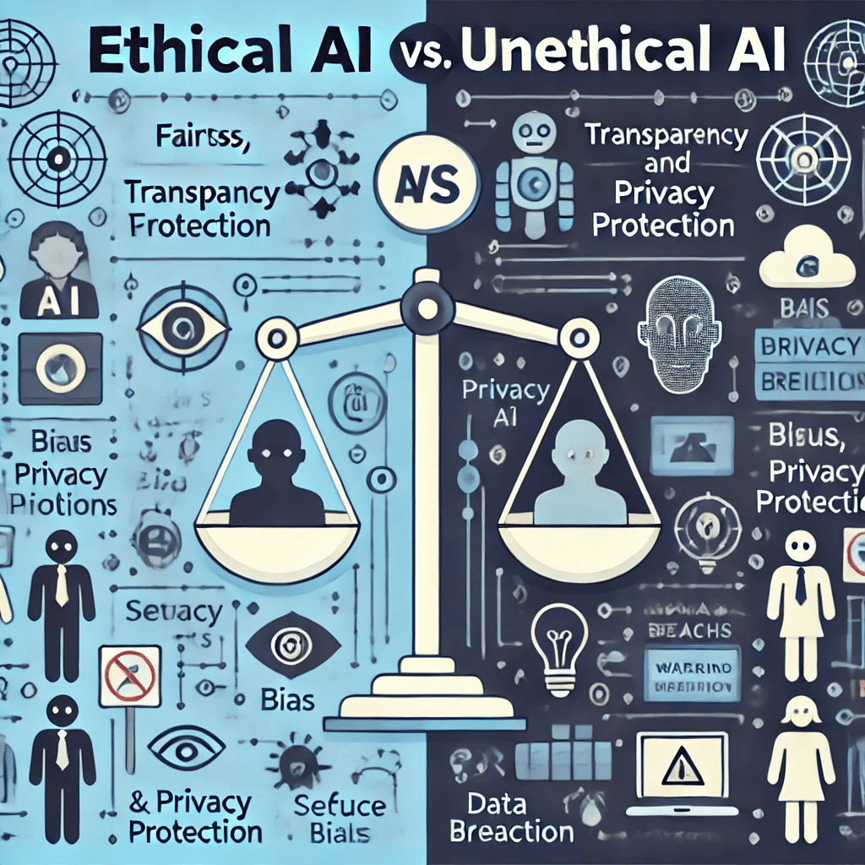
Ethical & Privacy Concerns in AI
Bias & Fairness
AI systems can reinforce societal biases due to flawed training data.
Fact: 78% of AI researchers agree that bias in AI is a major issue (Stanford AI Index, 2024).
ii. Autonomy & Control
As AI grows more autonomous, concerns arise over human oversight.
Who is accountable when AI systems fail?
Image of an AI-generated comparative diagram of Ethical AI vs. Unethical AI. It highlights the contrast between responsible, fair AI practices and unethical, biased AI behaviors.
TechLink Innovations...
27/02/2025
6
Notes:
6
02/03/2025

Slide 7
Ethical & Privacy Concerns in AI Cont.
iii. AI in Surveillance
Governments and companies use AI for mass surveillance, raising privacy alarms.
Example: China's AI-driven citizen monitoring system (BBC, 2024).
TechLink Innovations...
27/02/2025
7
Notes:
7
02/03/2025

Slide 8
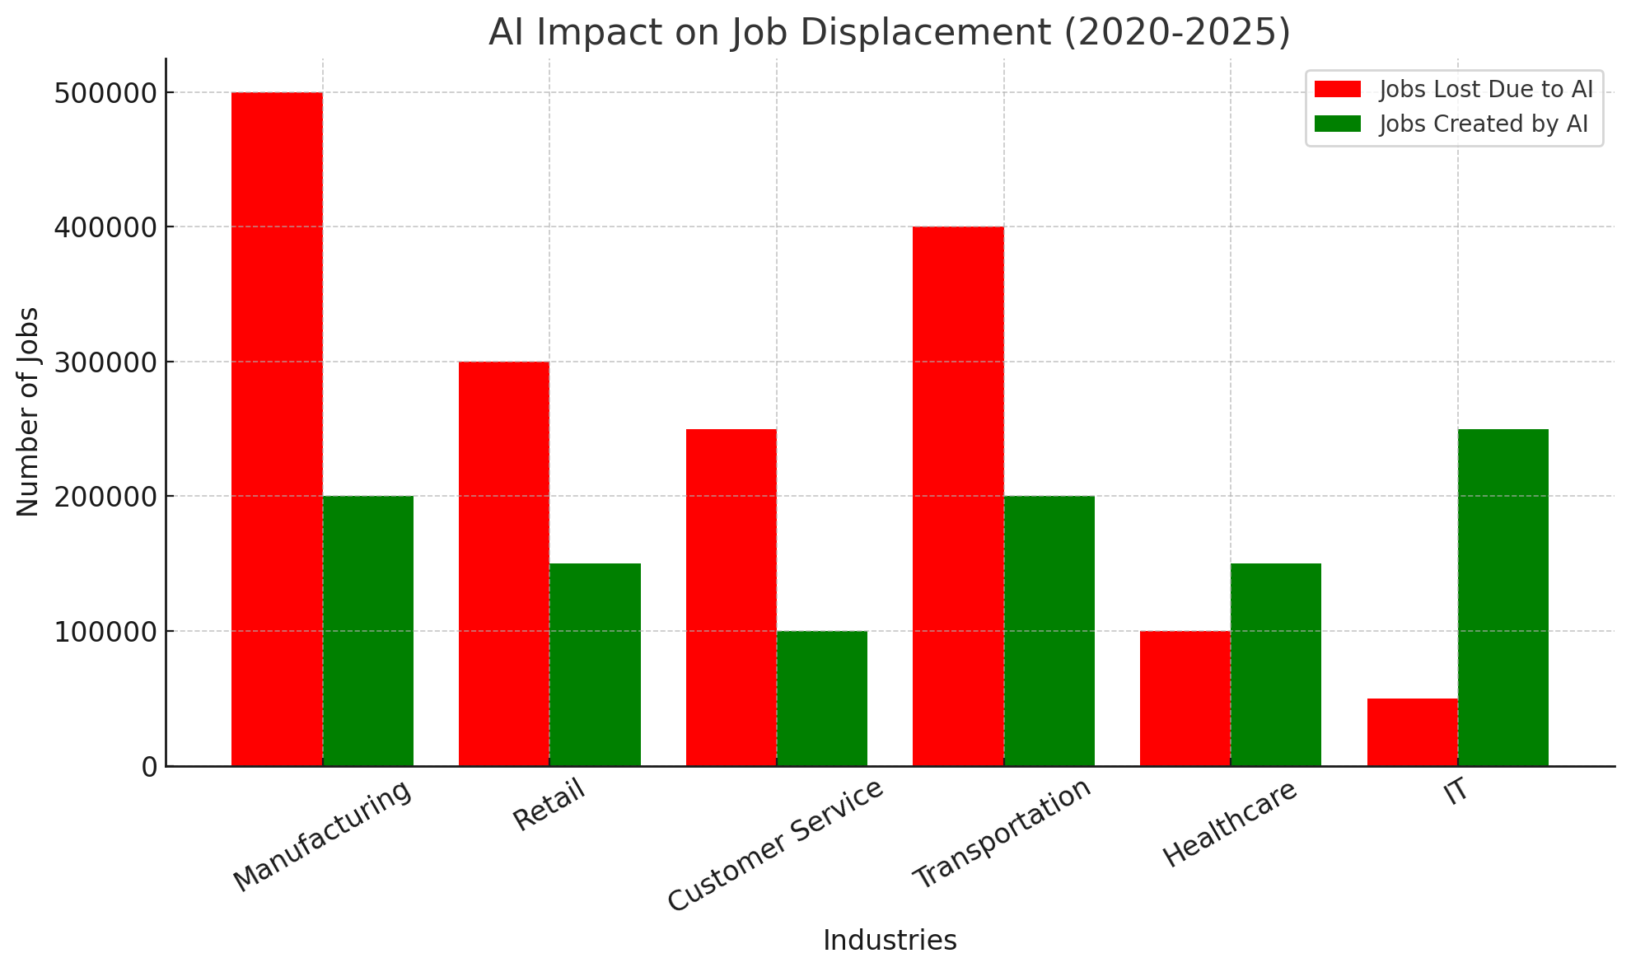
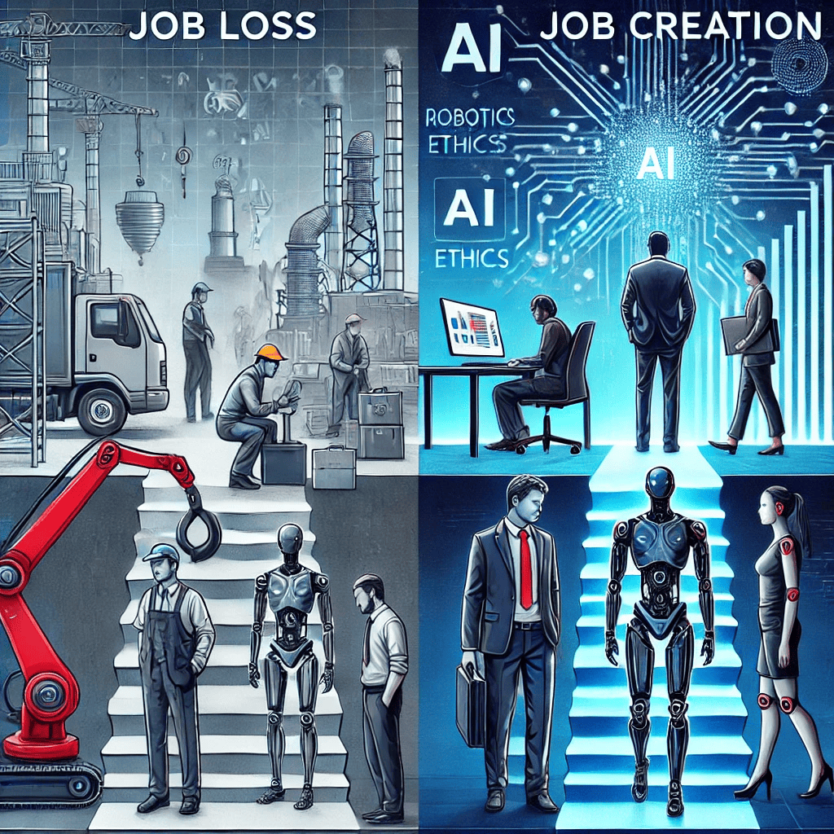
Job Displacement Due to AI: Impact on the Workforce
Jobs at Risk:
AI and automation are replacing roles in manufacturing, customer service, and even law.
Fact: AI could displace 85 million jobs by 2025, but also create 97 million new roles (World Economic Forum, 2024).
ii. Who is Most Affected?
Low-skill, repetitive jobs are most at risk.
New job roles demand upskilling and reskilling.
AI-generated visual representation of job loss vs. job creation in AI-driven industries. It highlights the contrast between workforce displacement due to automation and emerging opportunities in AI-related fields.
TechLink Innovations...
27/02/2025
8
Notes:
8
02/03/2025

Slide 9
Privacy & Security Concerns in AI: AI and Data Privacy Risks
i. Data Collection & Misuse:
AI relies on vast amounts of personal data, increasing risks of misuse
Example: The Cambridge Analytica scandal (though before 2020) set a precedent for AI data privacy concerns.
ii. Deepfake & Identity Theft:
AI-generated deepfakes pose threats to security and misinformation.
Fact: Deepfake-related fraud increased by 500% from 2022 to 2024 (Cybersecurity Journal, 2024).
Image of an AI-generated comparison of a deepfake vs. a real image, highlighting the differences between AI-generated fake content and a genuine human face.
TechLink Innovations...
27/02/2025
9
Notes:
9
02/03/2025

Slide 10
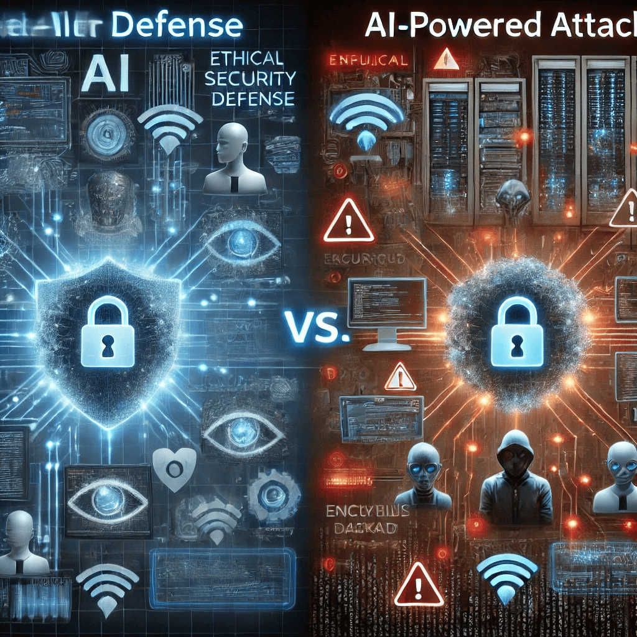
Security Risks and Cybersecurity Attacks in AI: AI-Powered Cyber Threats
i. Automated Hacking & AI-powered Malware:
Cybercriminals use AI to enhance hacking techniques, bypassing security defenses.
Fact: AI-driven phishing attacks have increased by 65% since 2022 (IBM Security Report, 2024).
ii. Adversarial AI Attacks:
Hackers manipulate AI systems by feeding them misleading inputs.
Example: AI-powered self-driving cars being tricked by adversarial road signs (Harvard AI Lab, 2023).
Image of an AI-generated comparison of AI in cybersecurity defense vs. AI-powered attacks, showcasing the battle between ethical AI security systems and malicious AI-driven cyber threats.
TechLink Innovations...
27/02/2025
10
Notes:
10
02/03/2025

Slide 11
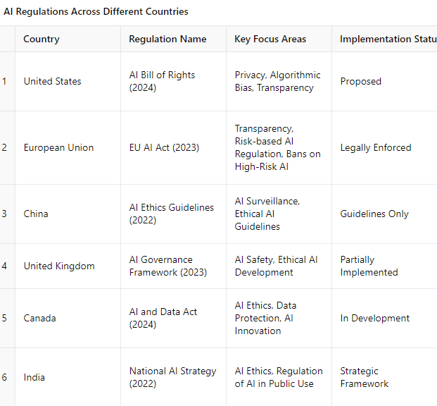
The Need for Transparency & Robust Regulatory Frameworks: Why Regulation Matters
i. Current AI Regulations
The EU AI Act (2023): First major AI regulation addressing transparency and ethical risks.
US AI Bill of Rights (2024): A framework for protecting citizens against harmful AI practices.
ii. Proposed Solutions
Ethical AI development with fairness checks.
Mandatory explainability of AI decisions.
Public-private collaboration on AI governance.
Table of a chart showing AI regulations across different countries, visually comparing global AI policies on data privacy, ethics, and governance.
TechLink Innovations...
27/02/2025
11
Notes:
11
02/03/2025

Slide 12
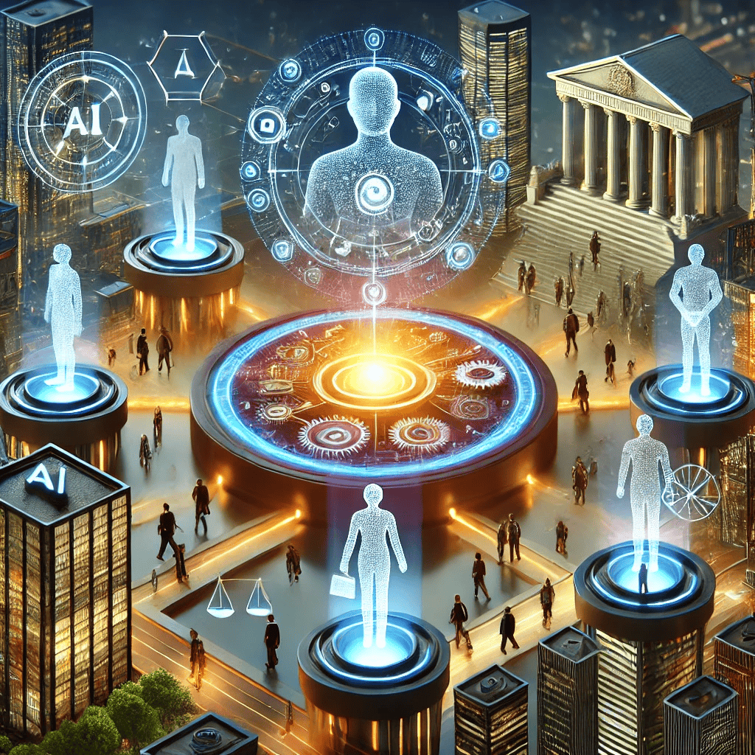
Future of Ethical AI & Responsible Development
Key Takeaways:
AI is powerful, but ethical, security, and societal risks must be addressed.
Governments, businesses, and AI developers must work together to create responsible AI solutions.
Continuous monitoring, transparent decision-making, and better education on AI risks are crucial.
Image of an AI-generated illustration of a balanced AI ecosystem, where humans, regulations, and technology work together harmoniously.
TechLink Innovations...
27/02/2025
12
Notes:
12
02/03/2025

Slide 13
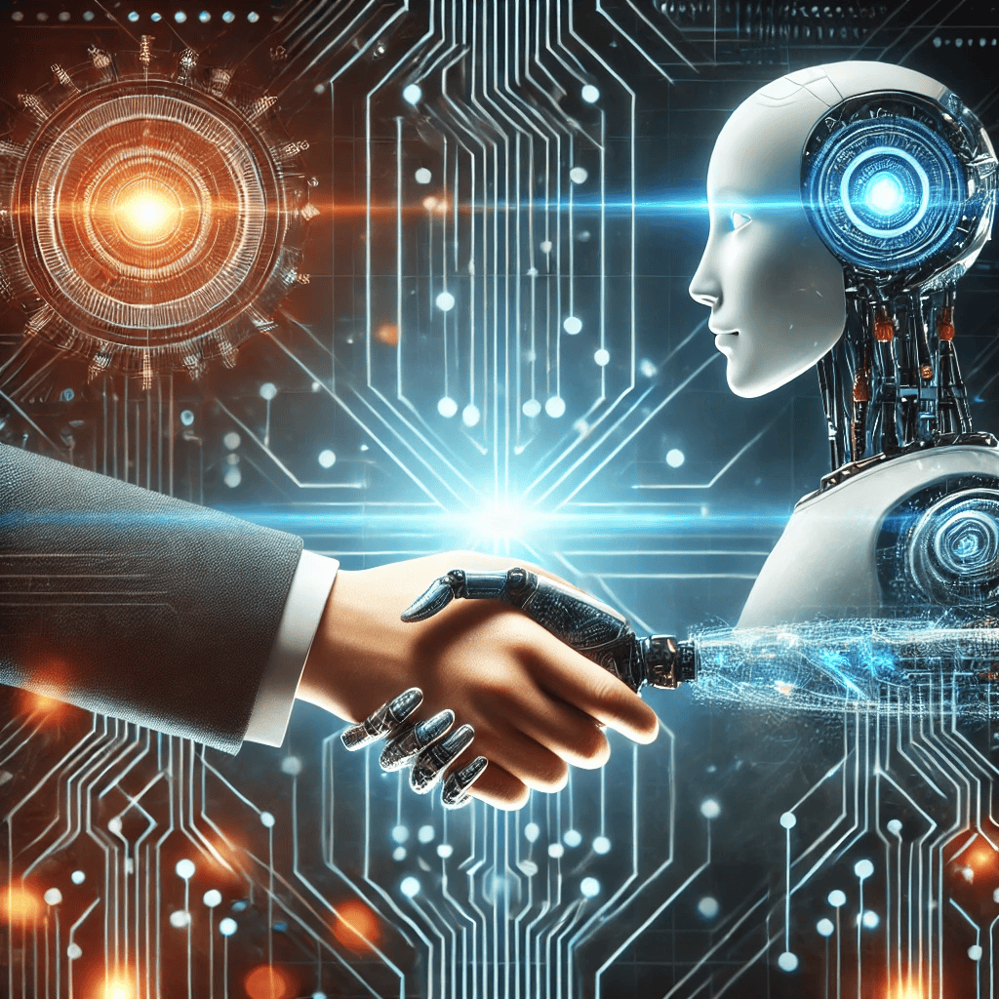
Conclusion & Call to Action
What’s Next?
Stay informed about AI policies and developments.
Advocate for responsible AI use in your industry.
Invest in ethical AI research and cybersecurity training.
TechLink Innovations...
27/02/2025
13
Notes:
13
02/03/2025

Slide 14
Let’s discuss! What are your thoughts on AI’s ethical and security risks?
For further questions, contact:
Josh
ceo@techlinkinnovations.com
www.techlinkinnovations.com
Thank You!
TechLink Innovations...
27/02/2025
14
Notes:
14
02/03/2025

Slide 15
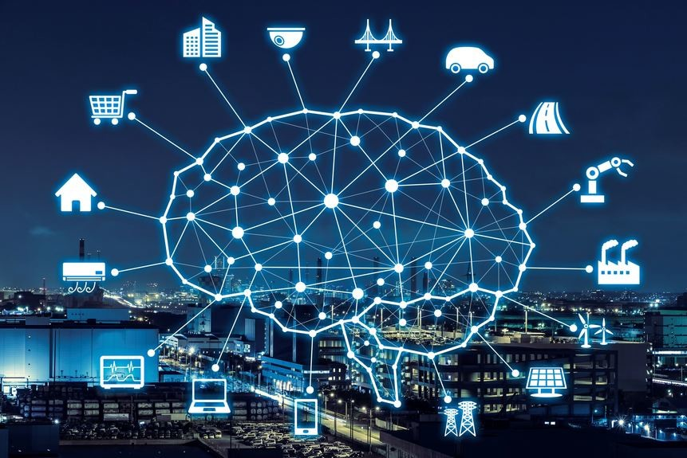
Citations (2020-2025) Used in the Presentation:
PwC (2024) – AI’s contribution to the global economy is expected to reach $15.7 trillion by 2030. Source: PwC Global AI Study (2024)
Stanford AI Index Report (2024) – 78% of AI researchers acknowledge AI bias as a major concern. Source: Stanford AI Index Report (2024)
World Economic Forum (2024) – AI is projected to replace 85 million jobs but also create 97 million new jobs by 2025. Source: WEF Future of Jobs Report (2024)
Cybersecurity Journal (2024) – AI-driven deepfake fraud cases increased by 500% between 2022 and 2024. Source: Cybersecurity Journal, Vol. 18, 2024
IBM Security Report (2024) – AI-powered cyberattacks have risen by 65% since 2022. Source: IBM Security Intelligence Report (2024)
McKinsey AI Report (2024) – 60% of companies lack AI governance policies for responsible AI deployment. Source: McKinsey Global AI & Risk Report (2024)
EU AI Act (2023) – The first major AI law passed in the European Union to regulate AI transparency and ethics. Source: European Commission, AI Act (2023)
US AI Bill of Rights (2024) – Framework created to protect citizens from AI-related risks in the United States. Source: White House Office of Science and Technology Policy (2024)
Financial Times (2023) – AI-powered trading bots contributed to a market crash in 2022. Source: Financial Times AI & Markets Report (2023)
BBC (2024) – China’s AI-driven citizen monitoring system raises global ethical concerns. Source: BBC Technology Report on AI Surveillance (2024)
TechLink Innovations...
27/02/2025
15
Notes:
15
02/03/2025

