Slide 1
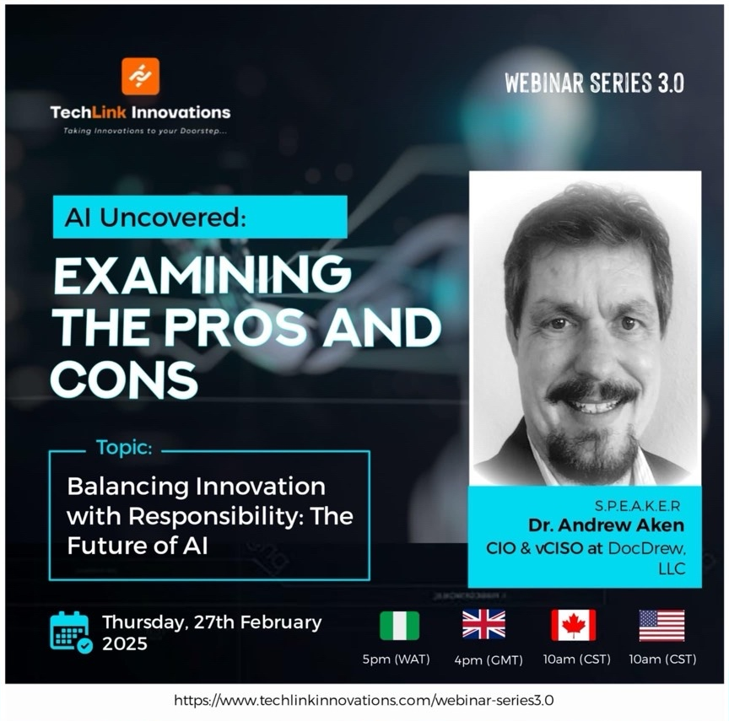
Balancing Innovation with Responsibility: The Future of AI
Notes:
Boards of directors are approving generative AI investments without fully anticipating the strategic, governance, and adoption challenges necessary to derive value from AI.
Boards that ignore AI will find their companies too far behind to catch up. But boards who invest without understanding the conditions for generative AI will have the equally concerning problem of investments without return or potentially lethal ethical and legal consequences.

Slide 2
Agenda
z
Current AI Landscape
Emerging AI Trends
Ethical & Social Challenges
Policy Implications
RAG for Security & Privacy
Strategies for Responsible AI Adoption
Fostering Inclusivity
Q&A and Closing Remarks
TechLink Innovations

Slide 3
Current AI Landscape
AI in Daily Life
Recommendations
Virtual assistants
Fraud detection
Rapid Growth
Deep learning
GenAI
Market Forecast
> $190B in 2025
Notes:
Highlight AI’s ubiquity in everyday tools.
Mention ongoing rapid advancements and market growth.
Use data or anecdotes to illustrate how AI is woven into modern businesses.

Slide 4
The Potential of AI
Efficiency & Productivity
Automate common tasks
Innovation
New business models
Product development
Personalized services
Social Good
Healthcare diagnostics
Climate modeling
Notes:
Stress how AI can transform processes and free human talent for more strategic work.
Provide compelling examples of AI’s positive societal impact.

Slide 5
Emerging AI Trends
Generative AI
ChatGPT
DALL-E
Edge AI
Moving AI to edge devices
Explainable AI
Transparency in results
AI & IoT convergence
Notes:
Reduce latency & increase privacy (with proper protections in place)
Real-time data analytics on IoT devices

Slide 6
Ethical & Social Challenges
Bias & Fairness
Algorithmic discrimination
Representative data
Privacy & Security
Personal data collection
Cyber vulnerabilities
Job Displacement
Accountability & Transparency
Who’s responsible for AI
Notes:
Highlight that AI can perpetuate biases if the training data is not managed responsibly.
Emphasize balancing personalization with privacy.
Think back to the massive restructuring of jobs and business that occurred during the Industrial Revolution and the Information Revolution – more jobs were created than were lost
Note the importance of clarity on who is liable for AI-driven decisions.

Slide 7
RAG for Security & Privacy
What is RAG
Retrieval-Augmented Generation
Why It Matters for Security & Privacy
Reduced data exposure
Granular access controls
Targeted information retrieval
Notes:
AI models retrieve relevant information from a trusted data source before generating responses.
Reduced Data Exposure: Sensitive data can remain in a secure repository rather than in a model’s training dataset.
Granular Access Controls: RAG setups can enforce permissions, preventing unauthorized access to confidential information.
Targeted Information Retrieval: Limits the model’s search scope to vetted sources, mitigating risks of hallucinations or disclosing sensitive details.
RAG can help address “hallucination” issues by grounding outputs in verifiable, stored information.

Slide 8
Policy & Regulatory Implications
Global Landscape
EU AI Act
Standards & Guidelines
IEEE, ISO, NIST
Corporate Governance
Internal ethics committees
Oversight boards
Stakeholder engagement
Notes:
Schoolhouse Rock: I’m just a bill – yes, I’m only a bill. And I’m sitting here on Capital hill
1.1 EU AI Act (Proposed Legislation)
Overview: The AI Act is a first-of-its-kind proposed regulatory framework that classifies AI systems based on risk (e.g., minimal, limited, high, unacceptable) and imposes corresponding obligations.
Key Provisions:
Transparency Requirements: High-risk AI systems must undergo conformity assessments and be explainable.
Data Governance: Stipulates strict data quality and documentation rules to prevent bias and discrimination.
Penalties: Violations can incur fines of up to 6% of global annual turnover.
Status: The legislation is in the final stages of negotiation among EU institutions, with implementation potentially starting in 2024–2025.
1.2 General Data Protection Regulation (GDPR)
Overview: GDPR is Europe’s comprehensive data protection law that applies to the processing of personal data—highly relevant for AI training and usage.
Key Provisions:
Lawful Basis & Purpose Limitation: Organizations must have a valid legal basis (e.g., consent or legitimate interest) for data processing.
Right to Explanation?: While GDPR does not explicitly mandate a “right to explanation,” it does require meaningful information about automated decision-making logic, especially in significant decisions (e.g., credit approvals).
Penalties: Noncompliance can lead to fines of up to 4% of annual global turnover or €20 million, whichever is higher.
Urge organizations to not wait on external directives but to proactively adopt best practices.
Cite examples of corporate self-regulation or third-party certifications.
Involve your legal team from the outset to navigate emerging compliance issues, review vendor contracts, and develop your company’s AI policy. Don’t wait until the AI system has gone rogue to consult your counsel.

Slide 9
Strategies for Responsible AI Adoption
Establish Ethical Frameworks
Technical Safeguards
Bias detection
Explainable AI techniques
Cross-Functional Collaboration
IT, Legal, HR, Ethics teams
Continuous Monitoring & Auditing
Notes:
Urge the creation of actionable AI ethics policies.
Encourage bias checks at multiple stages of development.
Discuss ongoing model audits and real-time oversight.

Slide 10
Fostering an Inclusive AI Landscape
Diverse Teams
Community Engagement
Identify stakeholders and their needs
Educational Initiatives
Training
Mentoring
Public-Private Partnerships
Combine resources
Notes:
Stress diversity’s role in mitigating bias.
Suggest involving affected communities in AI design.
Advocate for broader AI literacy through training programs.

Slide 11
Next Steps
Key Takeaways
AI offers immense potential for innovation and social good
Ethical and inclusive practices are crucial to prevent harm
Ongoing collaboration between industry, government, and society
Call to Action
Integrate responsible AI principles and policies into your projects
Encourage cross-department collaboration and training
Stay informed on regulatory and ethical guidelines and regulations
TechLink Innovations

Slide 12
Thank you
Dr. Andrew Aken
DocAken@DocDrewLLC.com
https://DocDrewLLC.com
https://www.linkedin.com/in/ajaken

